Slide 1
Puberty/Human Development
Grade 6

Slide 2
Changes in Early Adolescence
What changes that will happen to your bodies
Hygiene
How to set goals
Steps to develop a positive self-concept
Nutrition

Slide 3
The Life Cycle
Birth-early/childhood
And
Late childhood/teenage
These two stages have the most growth

Slide 4
Do you have questions in how we change from a baby to an adult?

Slide 5
Hygiene
Daily bathing – washing removes dirt/oil and reduces bacteria
Using a deodorant or deodorant/anti-perspirant
Change into clean clothes

Slide 6
Sweat Glands
Eccrine glands
Produce clear, odorless sweat
Have been active since childhood
Located all over the body
Help to control body temperature, eliminate water, salt, and waste products

Slide 7
Sweat Glands
Aprocrine glands
These become active during puberty
Located under the arms and in the genital area
This perspiration causes body odor when it comes into contact with bacteria

Slide 8
Physical Changes at Puberty for Girls
The Five Tanner stages of development
Each girl’s progression through the stages will be slightly different according to her own body’s timetable

Slide 9
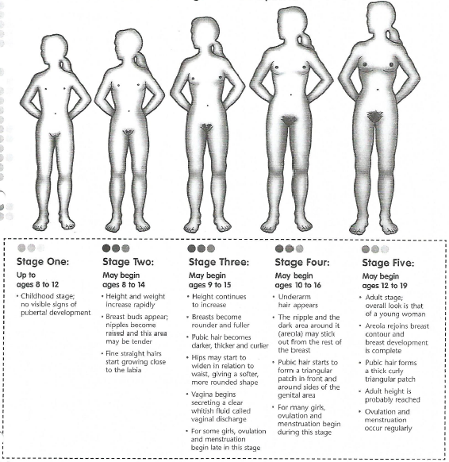

Slide 10
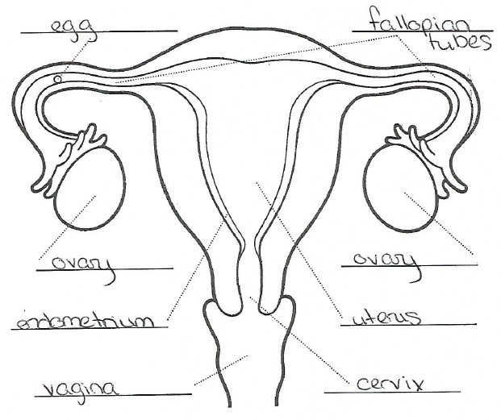

Slide 11
Vocabulary
Cervix – base of the uterus that has a small opening into the vagina
Egg – also called an ovum; the female reproductive cell
Fallopian tubes – two tubes connecting the ovaries to the uterus through which the egg travels
Ovary – two glands, one on either side of the uterus, that contain a woman’s egg cells and produce the hormones estrogen and progesterone
Uterus – also called the womb; a muscular organ lines with soft nourishing tissue that carries the fetus until birth
Vagina – the flexible passageway leading from the cervix to the outside of the body. Menstrual fluid flows out of the body through this

Slide 12
Physical Changes at Puberty for Boys
Each boy’s progression through the stages will be slightly different according to his own body’s timetable

Slide 13
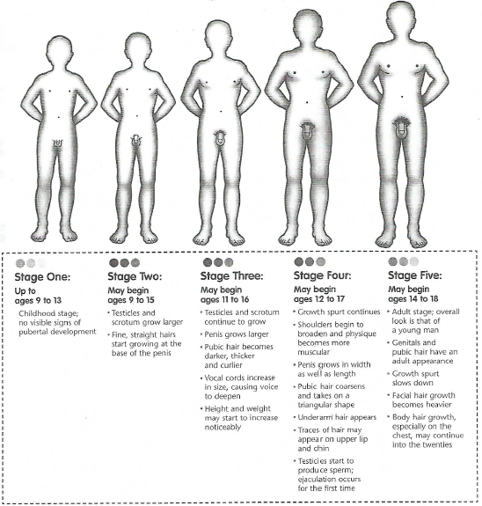

Slide 14
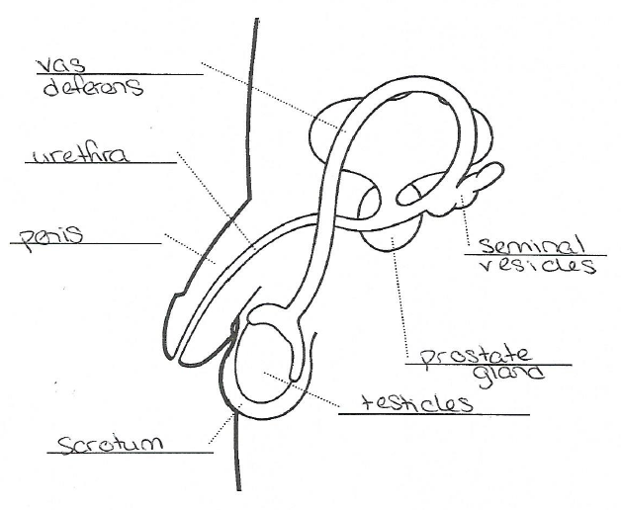

Slide 15
Vocabulary
Scrotum – sac of skin that holds the testicles, just underneath the penis
Seminal vesicles – two glands on either side of the bladder that secrete seminal fluid
Sperm – male reproductive cell
Testicles – also called the testes; two oval-shaped organs that are contained in the scrotum. They produce the male hormone testosterone and sperm.
Penis – male sex organ; also used to urinate
Prostate gland – gland next to the bottom of the bladder; it forms a fluid that combines with sperm and a fluid from the seminal vesicles to make semen
Urethra – tube that, at different times, carries urine and semen out of the body
Vas deferens – tubes in which sperm is combined with other fluids form the prostate gland and seminal vesicles to make semen

Slide 16
Nutrition
Five main food groups
1. grains – 6 servings a day
2. fruits – 4 servings a day
3. vegetables – 3-4 servings a day
4. dairy – 2-3 servings a day
5. meat – 3-6 oz a day

Slide 17
Calcium
Remember to consume about 1,300 mg of calcium per day
Foods that include calcium:
Milk, whole, lowfat, skim, yogurt, cheese, broccoli, almonds, milkshakes, pudding, frozen yogurt, ice cream

Slide 18
10 Steps to Self-Esteem
Know Yourself
Understand what makes you feel great
Recognize the things that get you down
Set goals to achieve what you want

Slide 19
Self-Esteem continued
Developing trusting friendships that make you feel good
Don’t be afraid to ask for help
Stand up for your beliefs/values
Help someone else
Take responsibility for your actions

Slide 20
10. Take Good Care of Yourself
Eating properly
Getting enough rest
Clean, well-groomed appearance
Learn what your body needs to stay healthy and fit
Exercise/relaxation activities

