Slide 1


PLATO-ACCESSIBILITY- TECH TIPS
Table of Contents
Tech Tip #1 – How to use Panopto Transcript Feature
Tech Tip #2 – How to Edit the Appearance of YouTube Video Captions
Tech Tip #3 –How to download a video transcript from Panopto
Tech Tip #4 – How to copy a video transcript from YouTube into a Word

Slide 2
Tech Tip #1
How to Use Panopto Transcript Feature

Slide 3
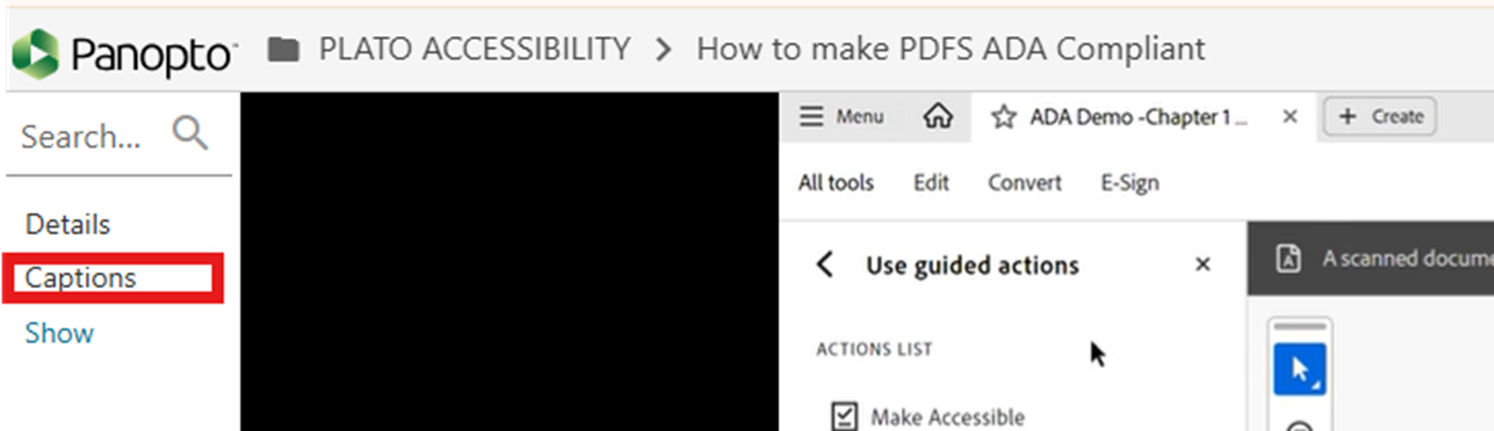
Click the “Captions” button on the left side of the video.

Slide 4
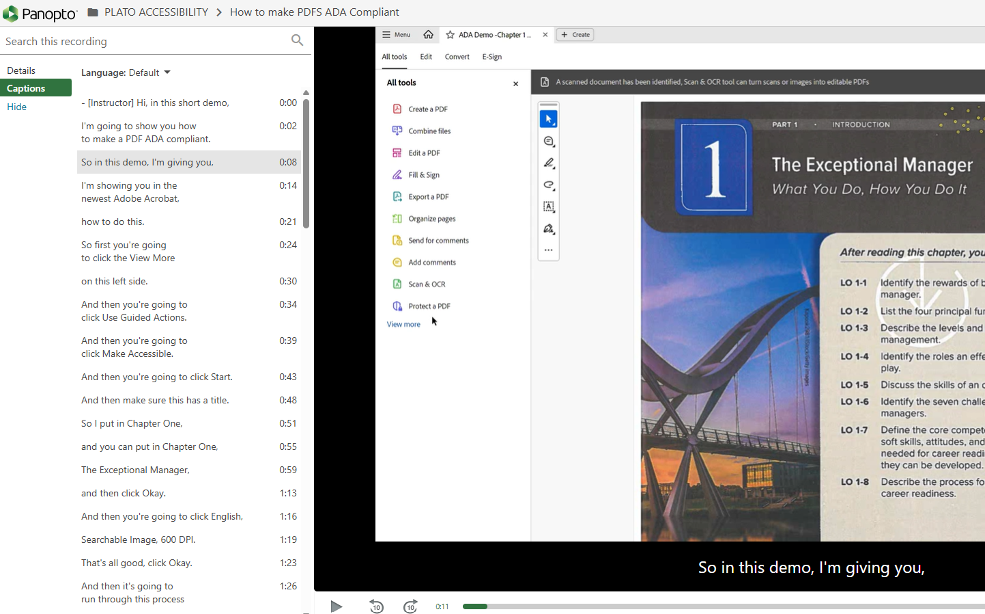
This will open the full transcript on the left side of the video. It will highlight what is being spoken in the video in real time. The image above shows what it will look like.

Slide 5
Tech Tip #2
How to Edit the Appearance of YouTube Video Captions

Slide 6
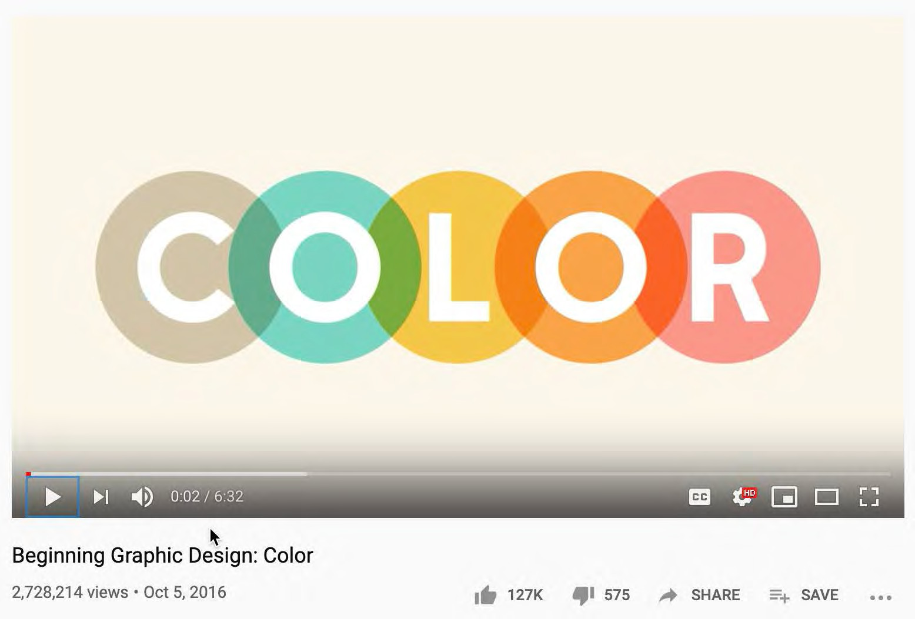
First click the CC button on the bottom Right side of the video

Slide 7
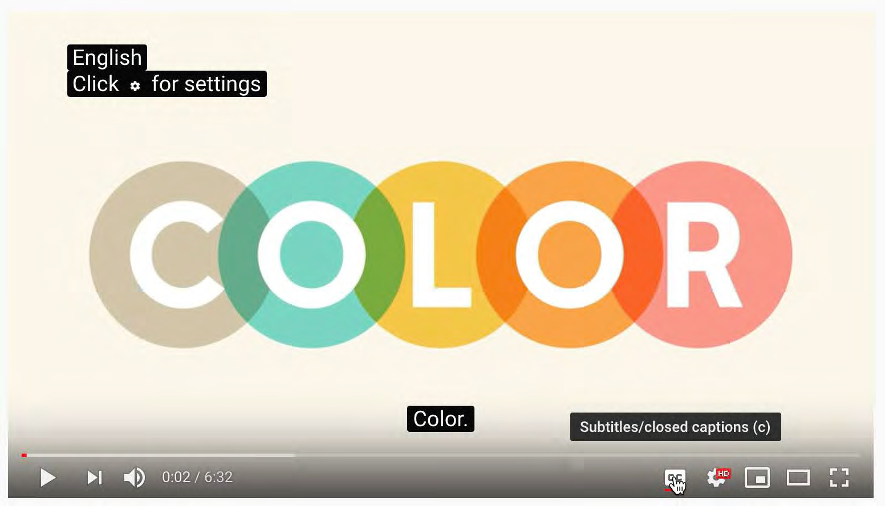
If it says “English” on the top left part of the video, that means the YouTube video has accurate captions

Slide 8
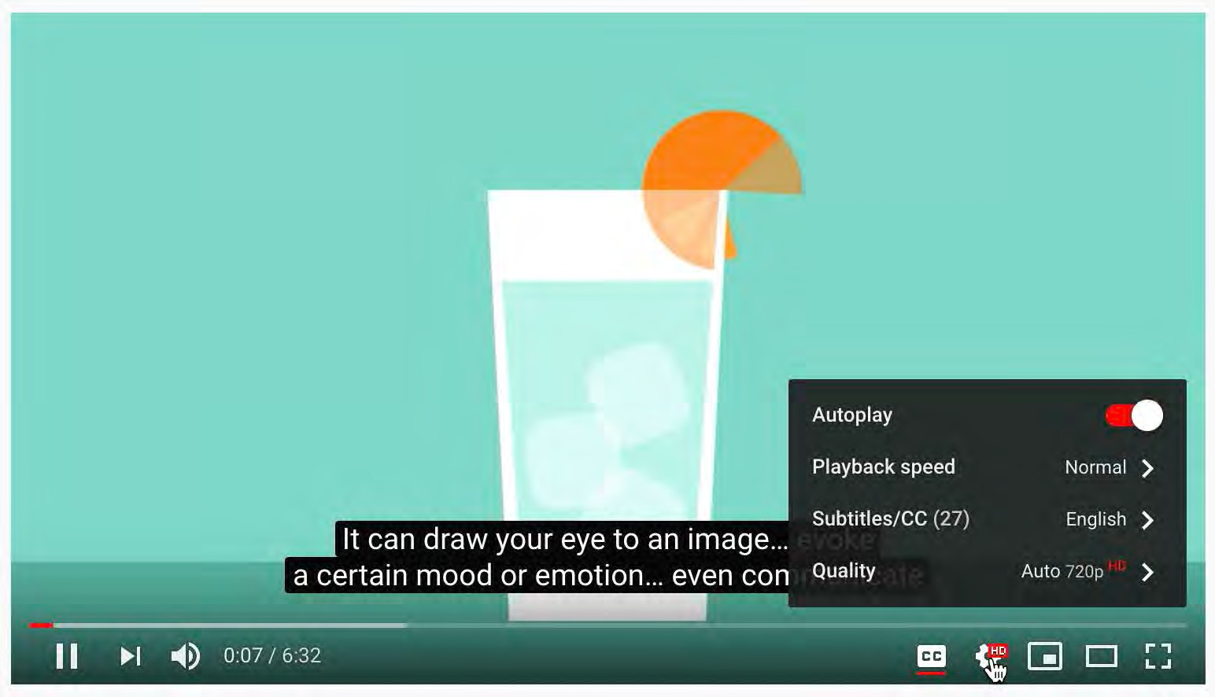
To edit the captions, first click the gear icon. Then click the “Subtitles/CC” Option

Slide 9
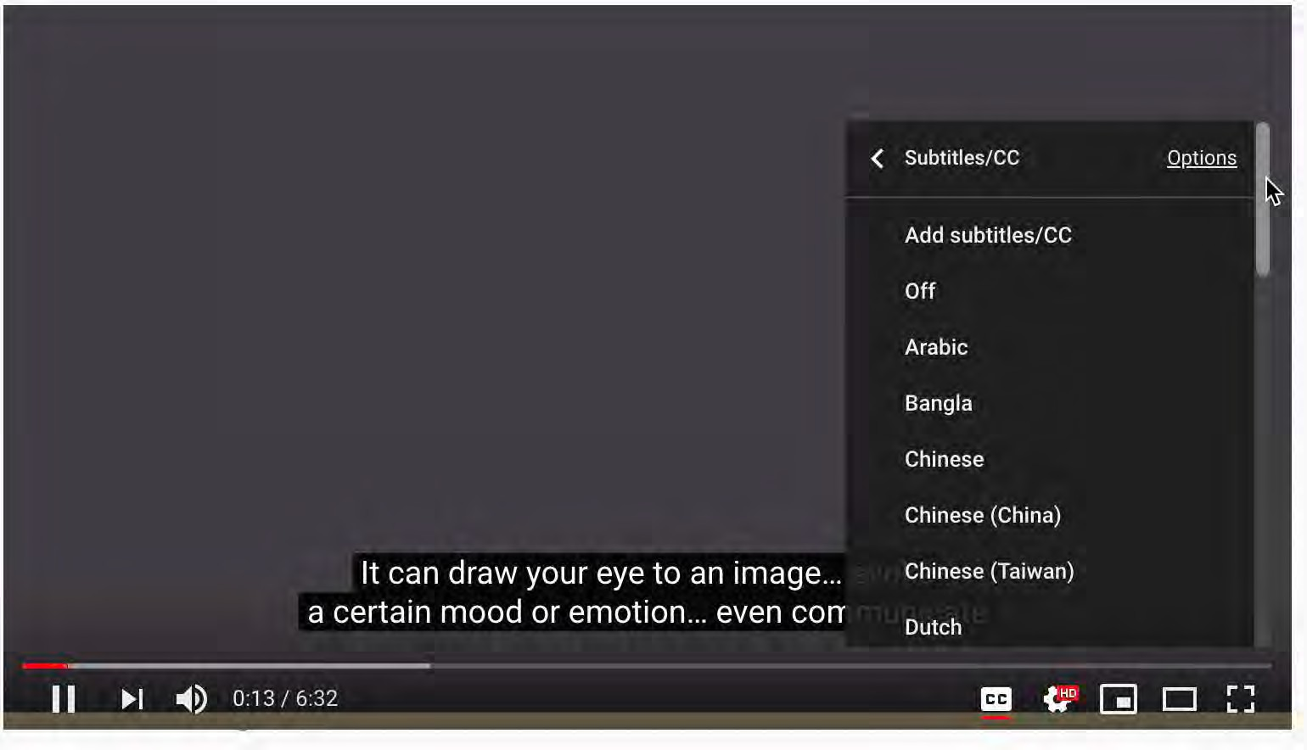
Next, move the scroll bar to the top, then click the “Options” button

Slide 10
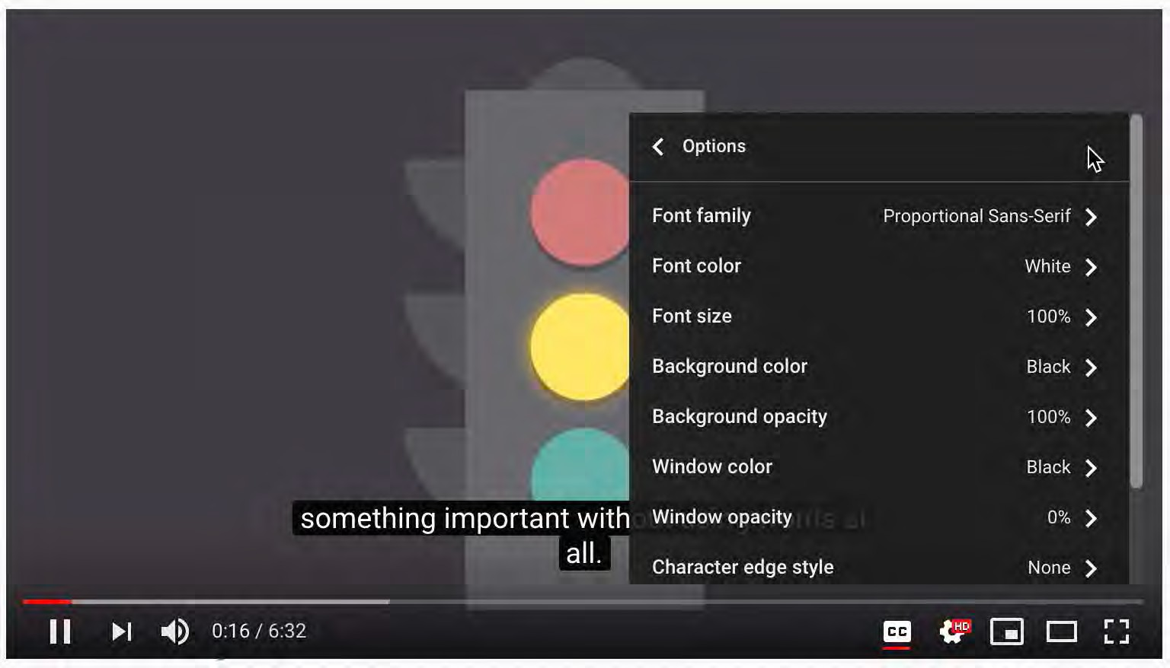
This will open a menu of options that change the way the subtitles look. Here you can make the font bigger, change the font color, and change the background color of the text as well.

Slide 11
Tech Tip #3
How to download a video transcript from Panopto

Slide 12
Click the “Captions” button on the left side of the video.

Slide 13
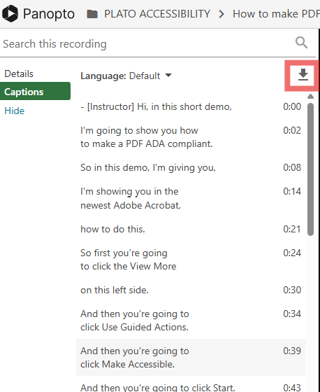
Next, click the Download Transcript Button. The .txt file will download to your computer.

Slide 14
Tech Tip #4
How to copy a video transcript from YouTube into a Word Document

Slide 15
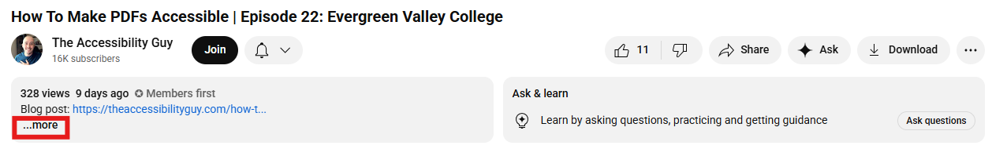
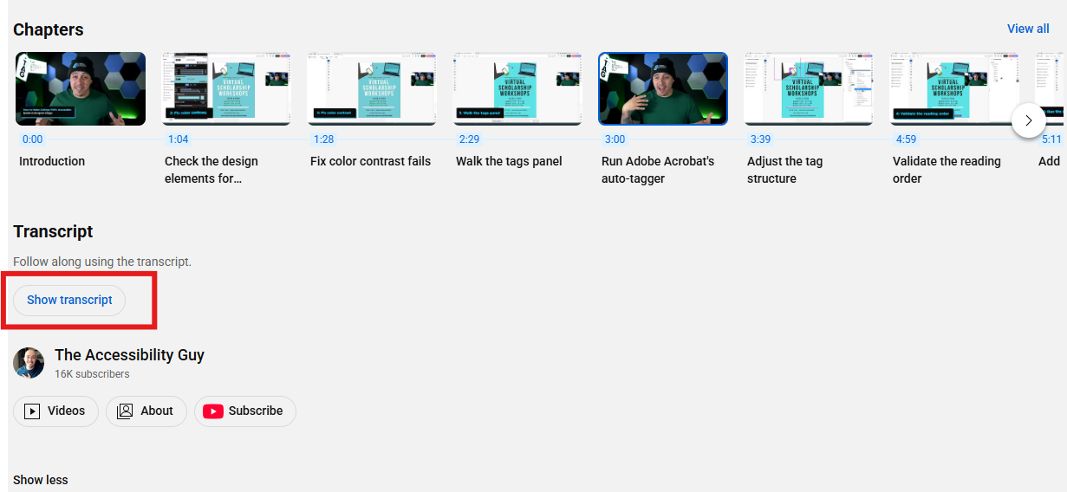
First, click “More” below the video. Then click "Show Transcript”

Slide 16
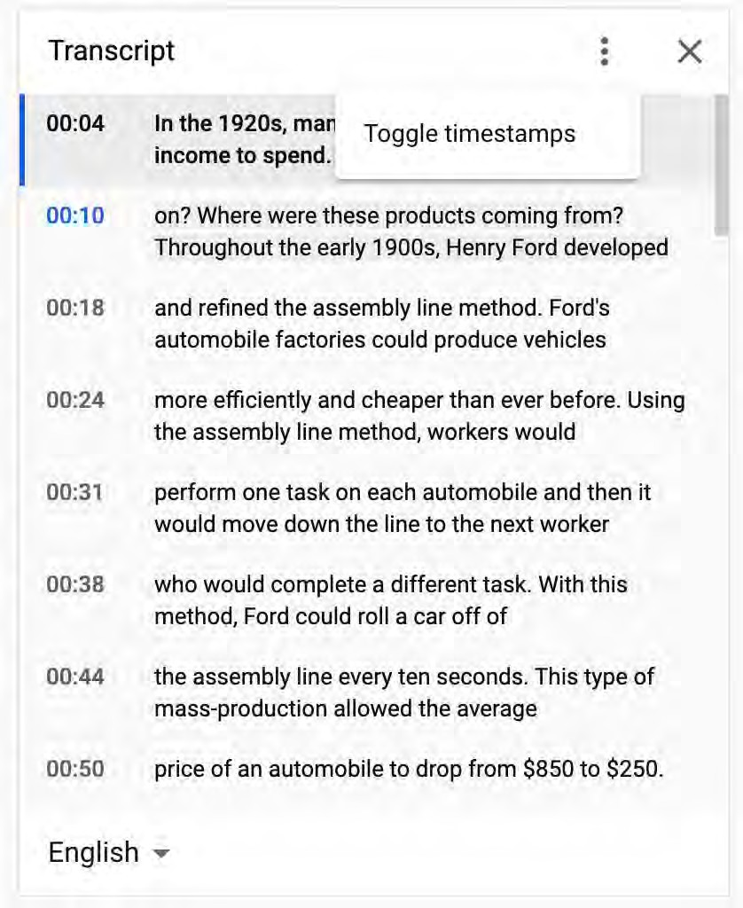
The Transcript Box will appear on the right of the video. Click the three dots above the Transcript. Then click the "Toggle timestamps” button

Slide 17
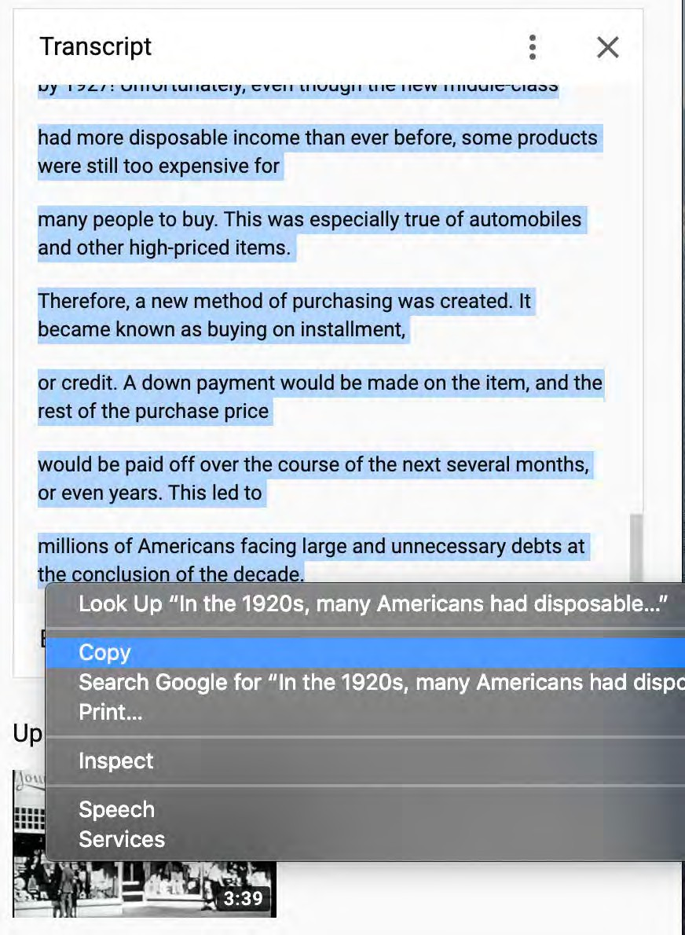
Then all you must do is highlight all the text, right-click the text, and click copy

Slide 18

Lastly, simply paste the text into a blank Word Document

